Slide 1

Safer travel
Explore crimes and travel safely . . .
Chicago

Slide 2
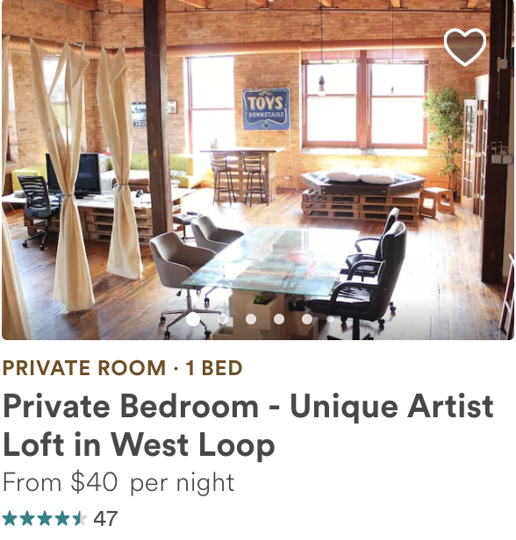
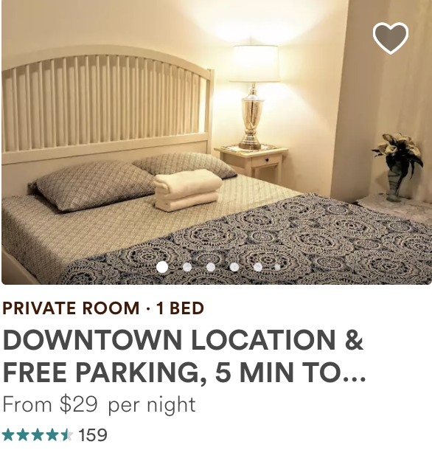
Which area is safer to stay?

Slide 3
Airbnb
Crime

Slide 4
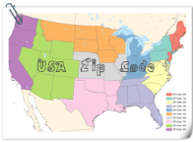


Data Portal
Crime
Airbnb
Web API
Zip Codes
http://insideairbnb.com/get-the-data.html
https://data.cityofchicago.org
http://pythonhosted.org/uszipcode/

Slide 5



ETL Process
Cleaning
• Delete missing data eg. No lat/long
• Correct data type
Extract
Transforming
• Aggregate data
Formulate new fields
- Eg. Day of week, Day of month
Map Crime, Airbnb and Zip code data
Transform
Load

Slide 6
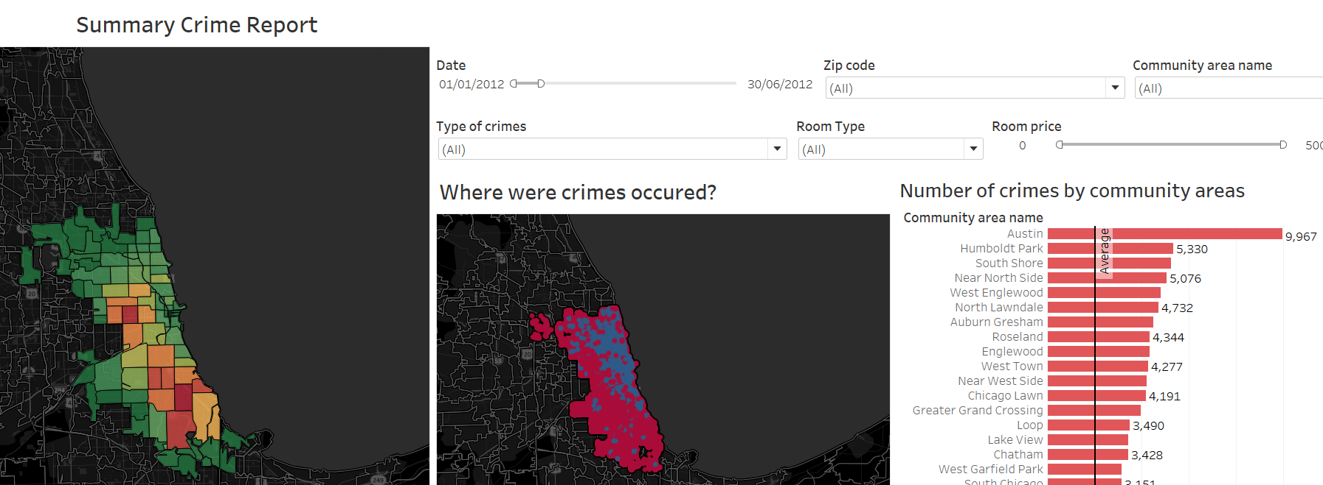
Most dangerous
Zip code area
60624 & 60619
Most dangerous
Community area
Austin

Slide 7
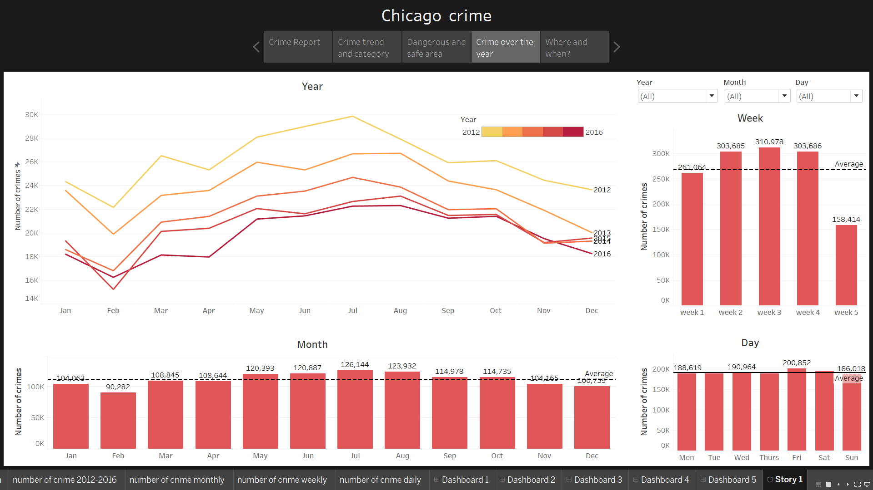
Most Dangerous
May – August
Week2 – 4
Friday
Most dangerous period
May - Aug
Safest Month
February
Crime depends on season!

Slide 8
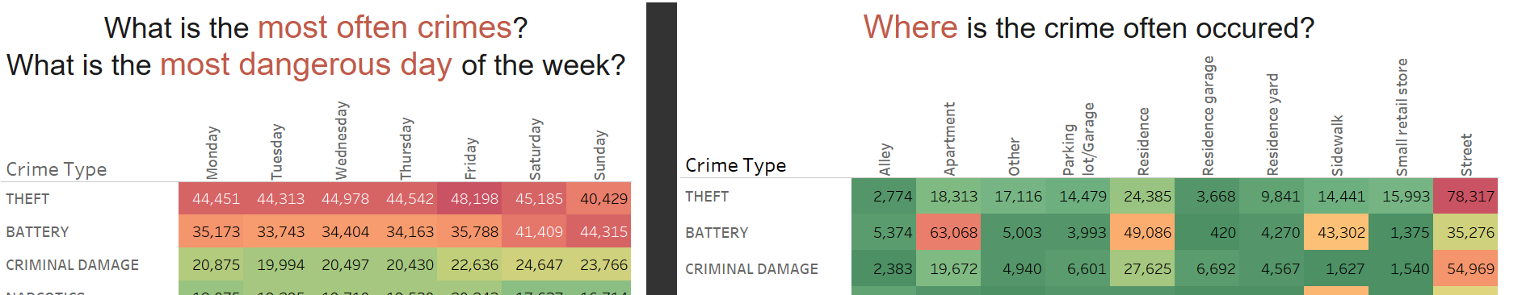
Type of crimes
Theft - Friday
Battery - Sunday
Theft - Street
Battery – Apartment, Residence, Sidewalk

Slide 9

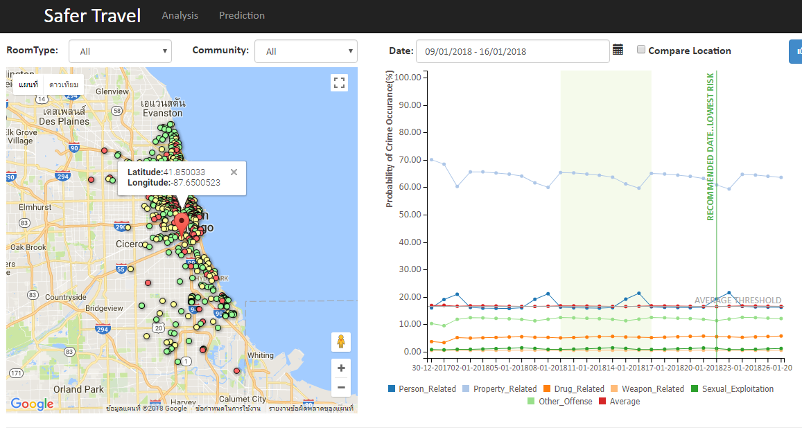

Features | Sample
Latitude | 41.880913
Longitude | -87.68152935
Day | 1-31
Month | 1-12
Day of week | 1-7
Season | 1-4
Crime
Probability
Notes:
Analysis just stat from the past W
Why ? Wouldn’t it be better that we can predict the chance that crime will happen in a specific location? Preditction is the answer!
Try ? We have tried it with linear regression and time series before and the results is not good enough Finally, we end up with classification model here!.
What tools? We uses Python lib called scikitslearn
How? We use nnw to classify, in the specific location, which crime category will happen in the future and then calculate the probability that each crime will happen at that location! To show to the users
We use location and date feature to train the model.
- As we have 5 year data, we separate first4year for train set and last year as test
Then here is the performance of the model..
Why we need prediction?
Go back to our first question, Where is safer to stay?
Our
Why choos this model?
How we do?
Feedforward
Train2012-15 , test 2016
Feature
Resuts?

Slide 10
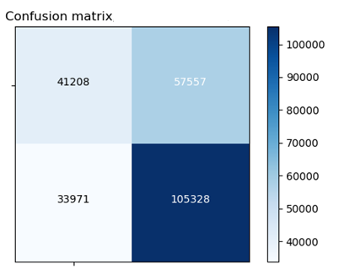
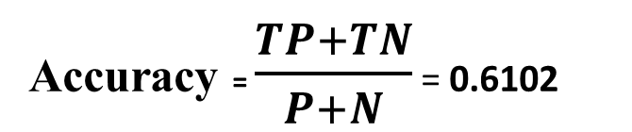
Crime group | Person | Property | Drug | Weapon | Sexual Exploit | Other offense | Avg
Accuracy | 0.7556 | 0.6102 | 0.9552 | 0.9856 | 0.9883 | 0.9004 | 0.8659
Prediction
No Crime
Has Crime
TN
FP
No Crime
Accuracy = $\frac{TP+TN}{P+N}$ = 0.6102
Actual
FN
TP
Has Crime
Notes:
We calculate accuracy of prediction in each category.
The accuracy is calculated from confusion matrix using the ratio of correctly predicted result divided by all of the test data.
The result is that in average around 86% that the model can correctly predict the crime category on a location.
Which is quite good!.

Slide 11

Analysis
Prediction
Where is the safest place?
When is the best time?
What is crime situation over years?
Stats of each crime group
Crime Probability
Compare Airbnb houses
Date Recommendation
Notes:
- We use Django python web framework to develop our application.
The app is divided into analysis part and prediction part
Analysis part focus on answers these question….
Prediction part can predict the chance that crime will happen in specific location
Compare Airbnb house which one is safer
Recommend safest date

Slide 12
DEMO

Slide 13
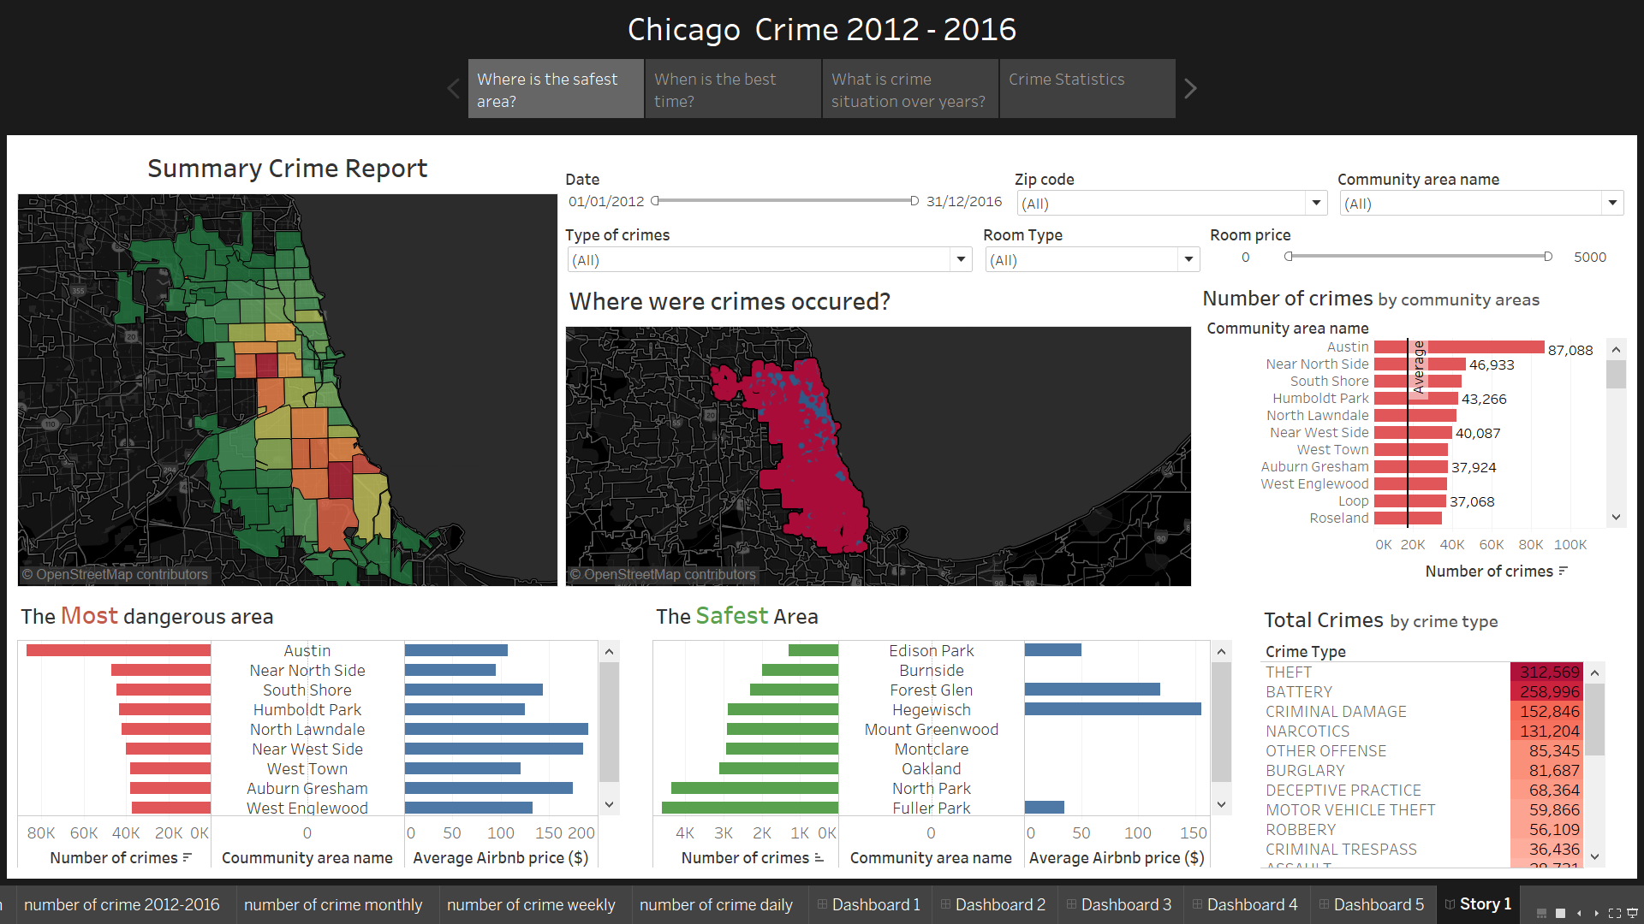

Slide 14
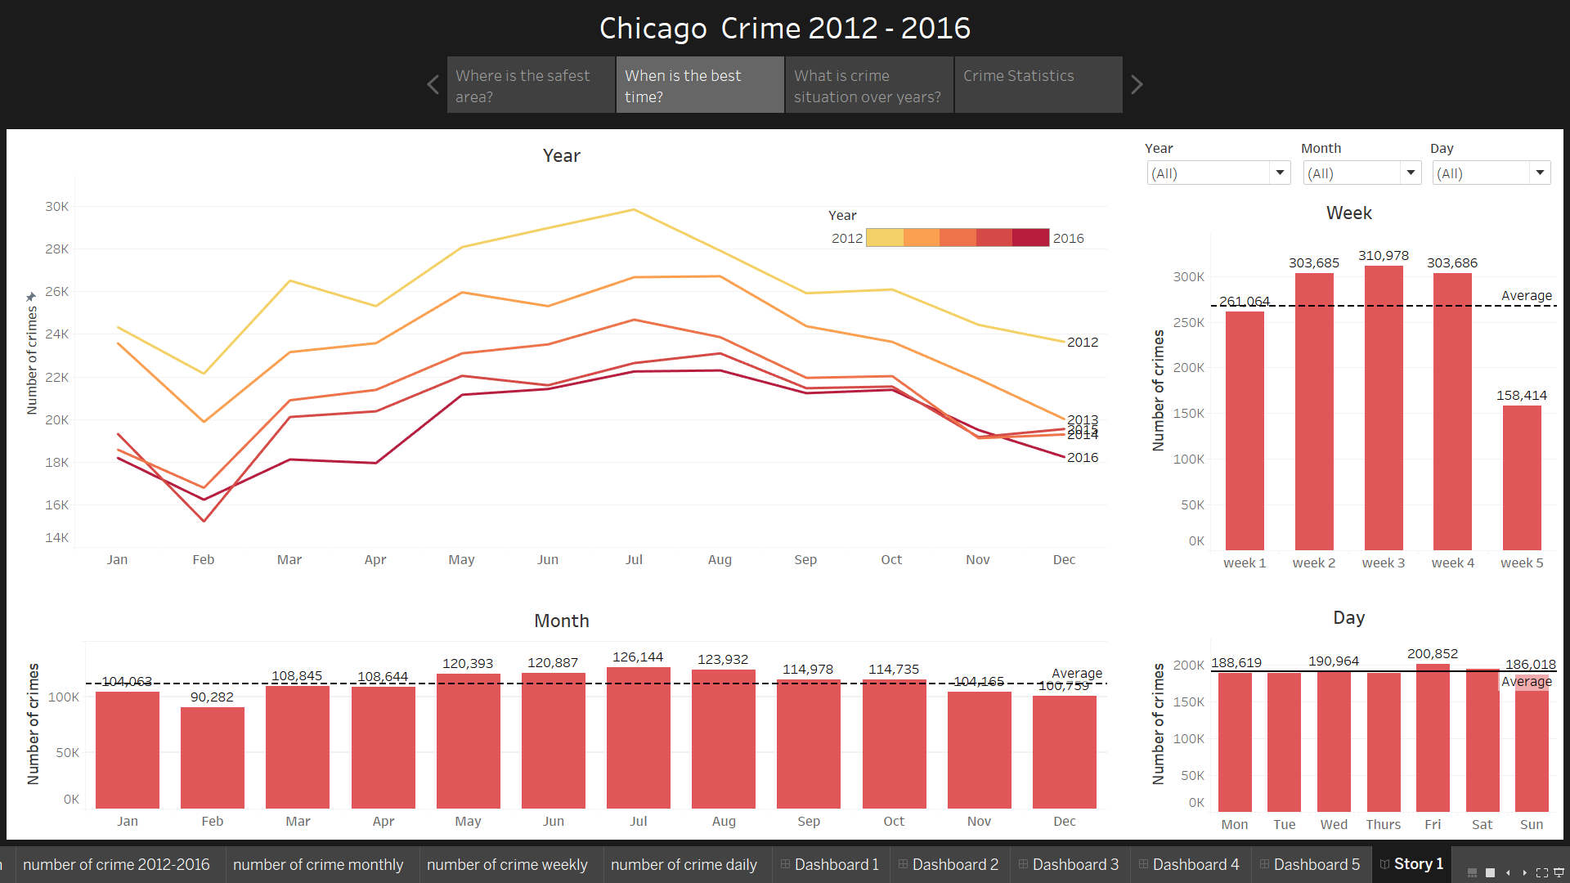

Slide 15
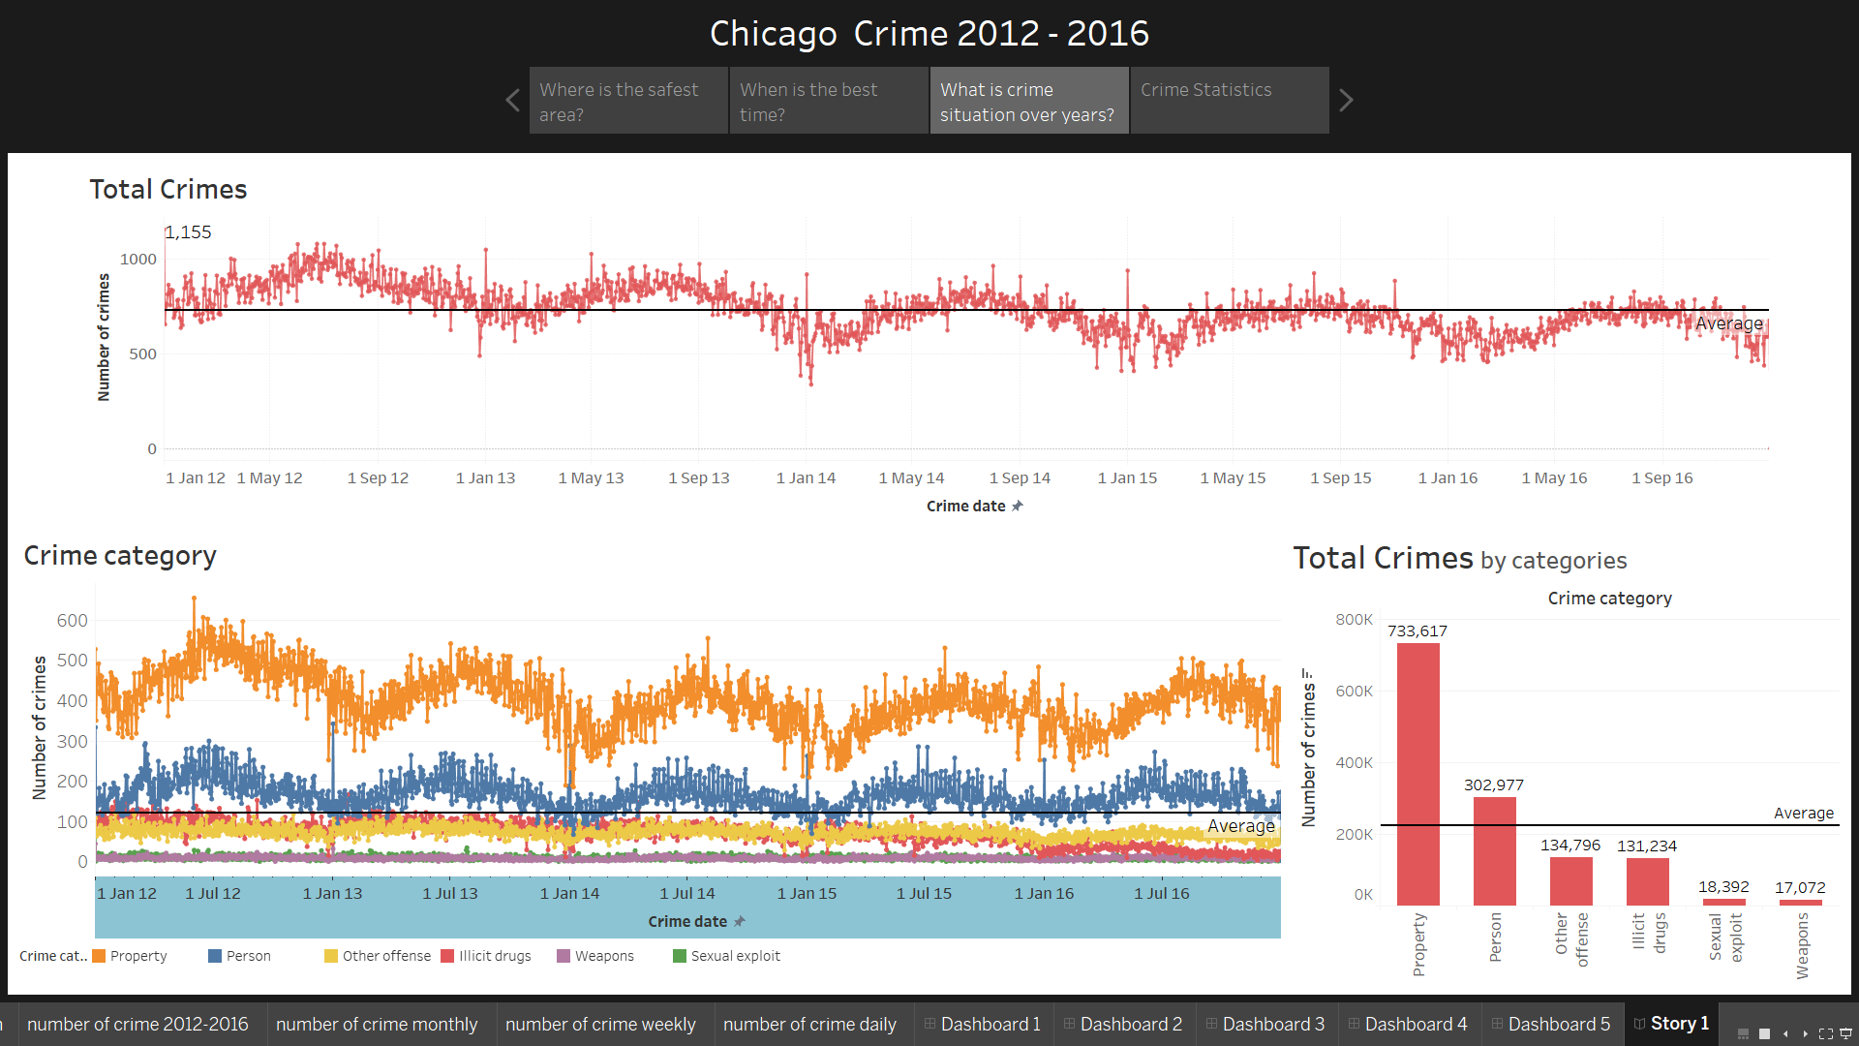

Slide 16
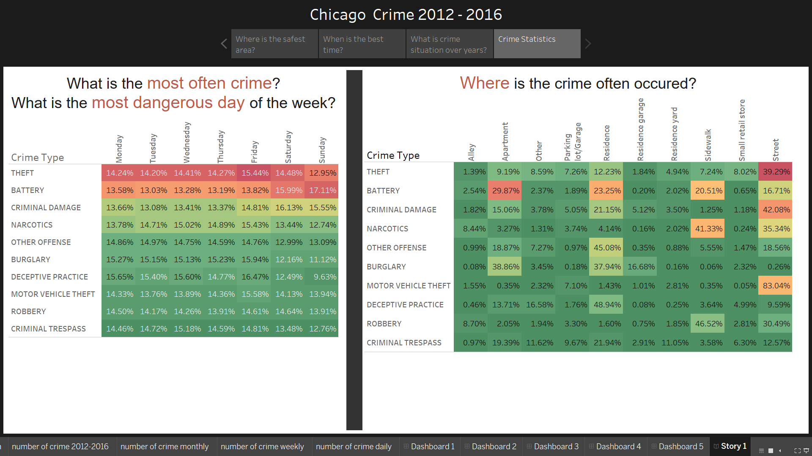

Slide 17
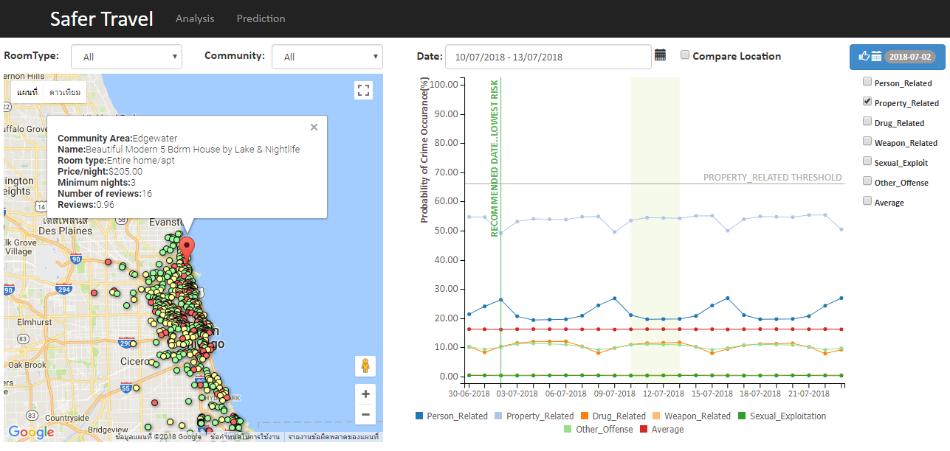
7
2
3
6
5
1
4
1 – Airbnb location
2 & 3 - Filters
4 – Crime probability by Crime group
5 – Threshold by Crime group
6 – Date Recommendation
7 – Compare mode

Slide 18
